Slide 1

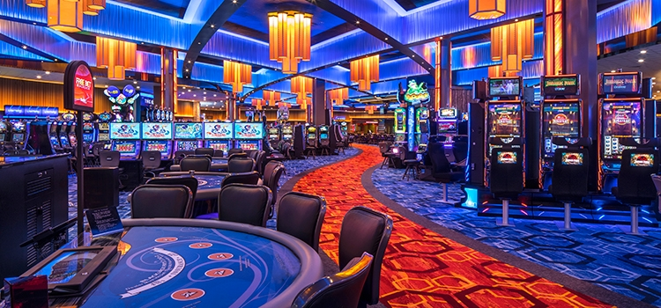
I AM GAMBLING
SE Dept.
Gambling platform based on BLOCKCHAIN
Students:
Moshe Malka 204769426
Aviv Rozia 201411477
Supervisor: Alexander Kesleman
Date: 05.07.2018

Slide 2


The alternatives of today
Expose identity
Trust the casino
Physical attendance
Expose personal information
Trust the casino
Centralized data base
Fraud and theft
Notes:
Short review about what we going to solve in our project:
1. The casino that everyone knows
2. The online casinos

Slide 3
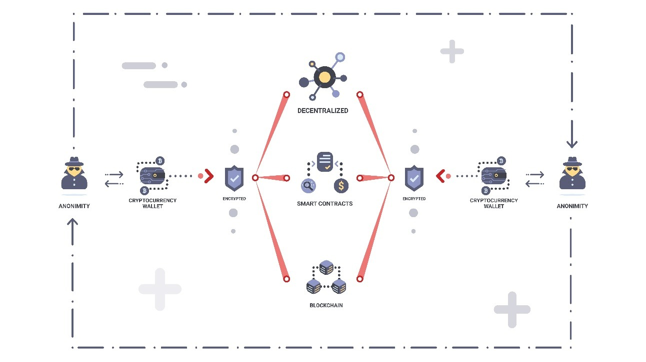
Introduction
Our project based on the Blockchain technology.
We assume that the Blockchain technology is the best way to solve the gambling problems
In our project we have two types of actors, the system administrator: who manage the system and provide games for the gamblers. The gambler: who can place his bet on the website and enjoy gambling within the Blockchain technology.
Notes:
Here we can see short demonstration about how the Blockchain protocol works, we have two sides one of them is the website and the other is the gambler, both of them has cryptography wallet, the website also contain the smart contract inside his wallet. Both of them connected to the decentralized Blockchain network and every action between them is operate within the network. In the next slides we will discuss in a more specific way about how this works.

Slide 4
motivation
With our solution we will create a simple and convenient gambling system based on the BLOCKCHAIN under lightning network.
Goals :
Improve privacy
Provide security
Provide transparency
Solve the double spending problem
Notes:
Our goals is to prevent the problems that we discussed on the previous slides such as to improve the privacy of the gambler by the fact each gambler has cryptography wallet and when you use the wallet there is no need to login or identify yourself. The next one is to provide a better security to the gambler by using the decentralized Blockchain network. The other goal is to provide transparency to every user thanks to the fact the Blockchain network built as an open and public ledger that everyone can see the history of all the actions in the network. Out last goal is to solve the double spending problems that exist in similar websites that also use the Blockchain technology for gambling. We will discuss more specifically on this problem in the next slides but in short this problem means that every person in the network can use his data couple of times until it being approved, we will solve this problem by using the lightning network.

Slide 5
Open ledger – a chain of transactions
A
B
A=10$
A→B=5$
A→C=15$
B→D=3$
D→C=1$
C
D
This is a centralized ledger, its open and public!
Notes:
In order to demonstrate how the protocol works we will demonstrate it by using money transfer. First lets note that today money transfer usually takes a couple of days on the other hand money transfer within the Blockchain network takes about 30 seconds.
Here is an example of a centralized ledger:…..
This was an example of a centralized ledger, in our project we will use decentralized ledger in order to achieve the blockchain advantages

Slide 6
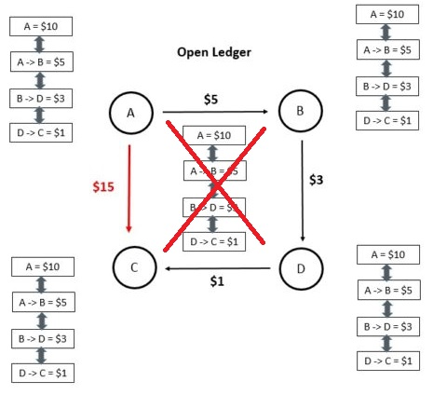
Distributed open ledger
Notes:
here we can see an example of a distributed ledger each node or each person holds the chain of transaction this provides the goals that we discussed before. Such as transparency and security, because if a person wants to change one block he need to change this block in all of the clients it’s a thing that almost impossible. One more point that we want to tell you about is that new problems aroused:

Slide 7
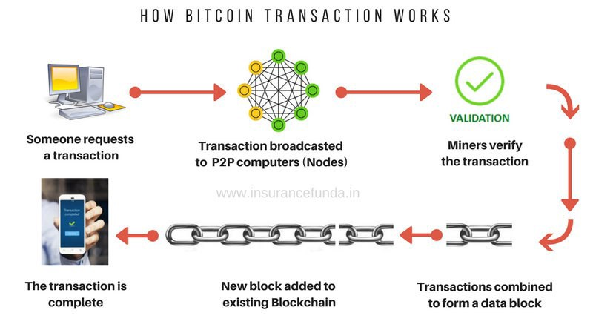
Validation process
Notes:
Now we will talk about the validation process, you probably ask yourself what is to validate. Validate means that someone need to prove that this action is legit. That someone called a miner. On the next slides we will talk about how the mining process being done.
Now we will go throw the chain of actions
Every block can hold certain amount of transaction in order to minimize the network trafic

Slide 8
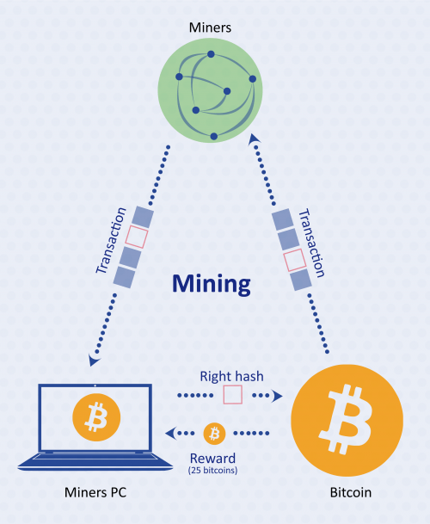
Miners
The validation process:
Validate
Find special key(hash code).
Broadcast to everyone.
All the other miners will add the transaction to their ledger.
Notes:
The miners is actually the actors that creates the blocks. Here we can see the pool of miners that is a network that all miners are connected to. When a new transaction arrives to the pool the Miners will compete among themselves about who is going to be the first one to validate the transaction by finding a special key once a miner found this key he broadcast it to the pool and all the other miners stop searching, then he gets a financial reward and all the other miners add this transaction to their ledger.

Slide 9
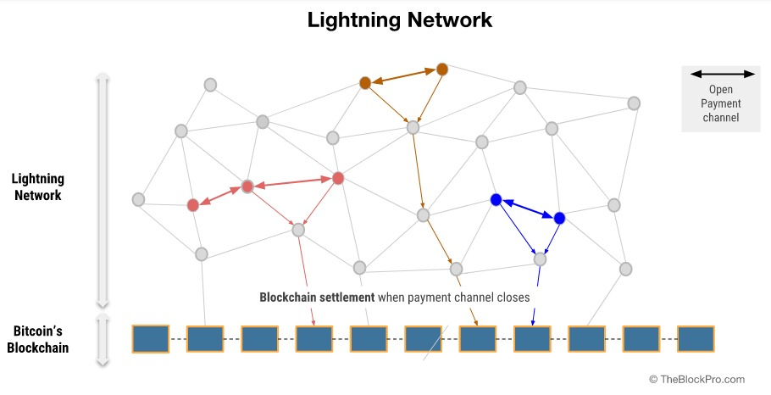
Notes:
In addition to the time optimization that I talked before thanks to using the blockchain network, lightning network offer even a better optimization.
lightning networks are sub networks of the main Blockchain network that provide high transaction speed and prevent high network traffic on the main network. As we said before a transaction on the main network takes about 30 seconds to operate on the lightning networks transactions being operate almost immediately.
This is done by the user creating a new wallet within the subnet and depositing money from the main network, the subnet uses the same protocol and therefore it implements all the block principles.
After the user has finished and wants to get his money back all he has to do is transfer the money from the subnet to the central network.

Slide 10
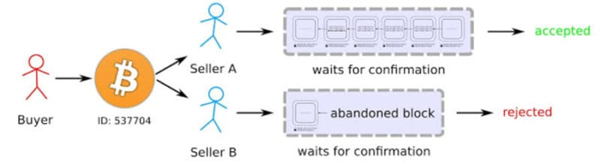
Block chain double spending
How the double-spending problem can be solved?
Transactions are public.
single history.
The earliest transaction is the one that counts!.
Notes:
So what is the double spending problem, to double spend means that you send your money twice while the first transaction not yet approved.
For example if someone has 10 dollars in his wallet and he send it to other person this transaction not yet approved but in meantime he send another 10 dollars to someone else, the network solves it by using timestamps for each transaction.
In addition thanks to the lightning network we minimize the option to double spending.

Slide 11
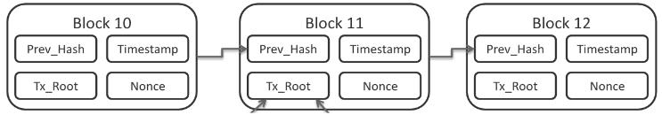
Time stamp
Notes:
This is an example of how the timestamp looks like each block has its own timestamp

Slide 12
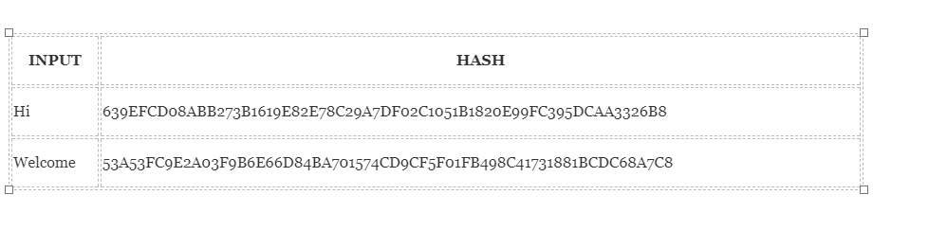
Hash-code
Hashing means taking an input string of any length and giving out an output of a fixed length.
Due to the high number of bits, the probability of collisions is close to 0.
No matter how big or small your input is, the output will always have a fixed 256-bits length.
Ethereum uses KECCAK-256 hash function

Slide 13
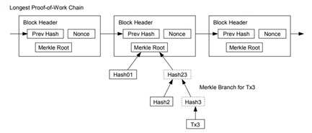
Merkle tree
Merkle tree is a hash based data structure that is a generalization of the hash list.
Merkle trees have a branching factor of 2, meaning that each node has up to 2 children
Merkle trees are used in distributed systems for efficient data verification
Notes:
1. The blockchain uses Merkle tree for hashing
2. Instead of providing a separate signature key and authentication key for each document, you can reduce the number of authentication keys to a single public authentication key that is actually the root of the tree.
3. This is how we going to provide security for our clients.

Slide 14
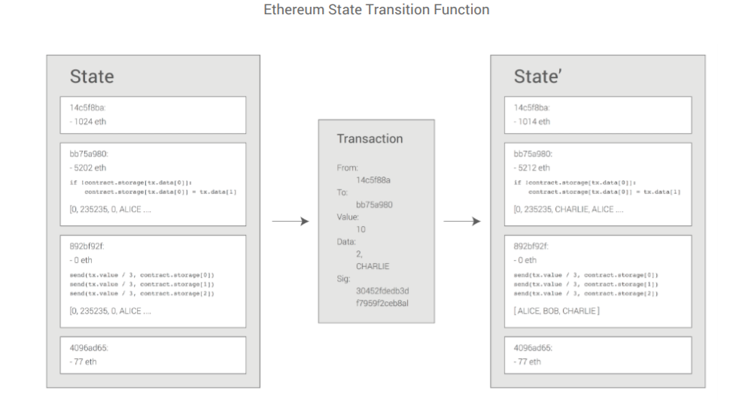
Smart contract
Notes:
1. Once its being signed no one can change it and no one can interfere it,
2. there is no go back for both of the sides,
3. Moreover everyone on the network can see it,
4. In addition to security this is how we will provide transparency to our clients.

Slide 15
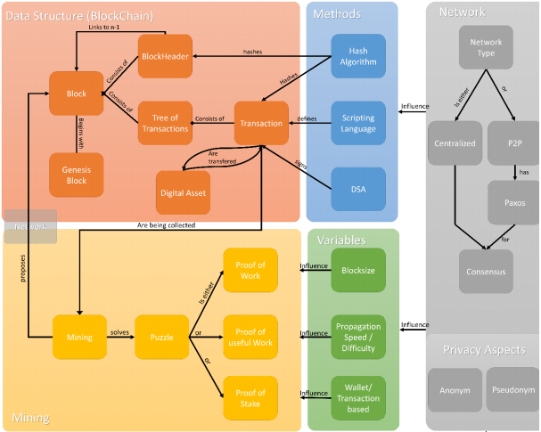
The architecture of BLOCKCHAIN
Notes:
Paxos - is a family of protocols for solving consensus in a network
Consensus - fundamental problem in distributed computing in order to achieve overall system reliability
DSA – digital signature algorithm
Block header – previous block, time stamp, Merkle root and so on…
The miners needs to solve mathematics puzzles using one of the 3 methods that exist in the protocol.

Slide 16
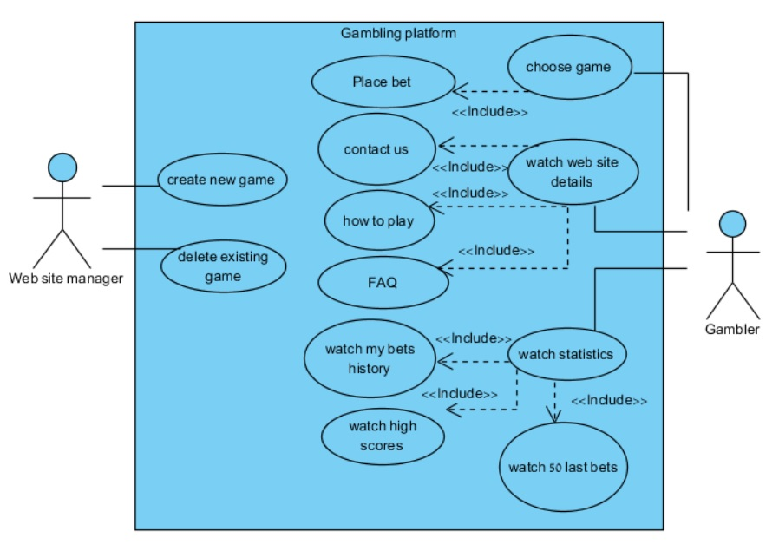
Use case

Slide 17
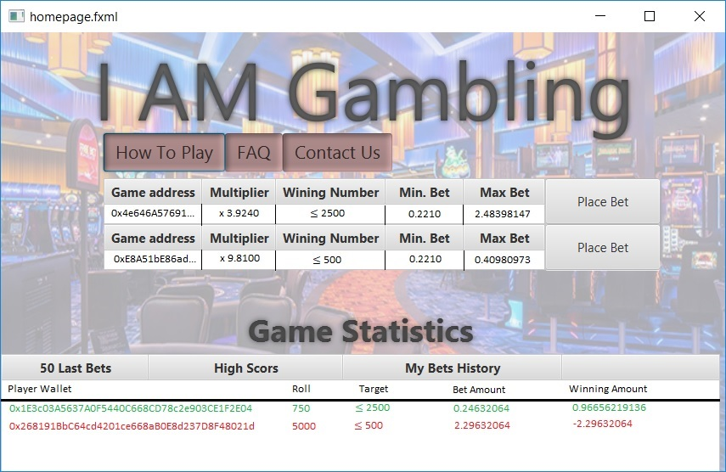
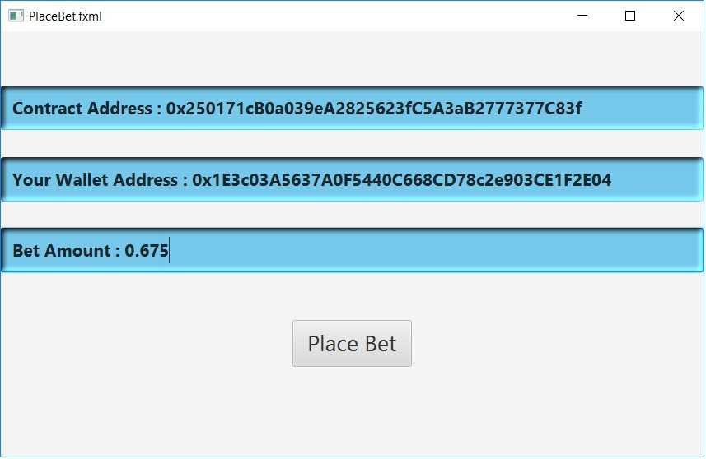
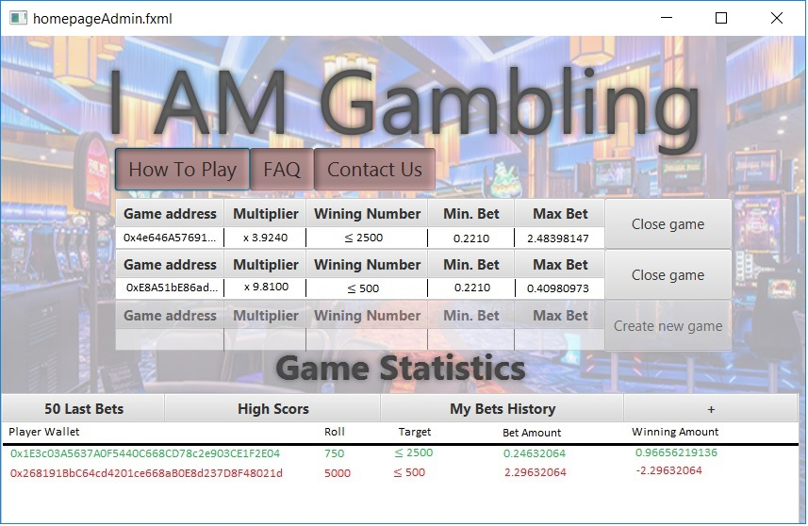
Main window GUI
User window
Administrator window

Slide 18
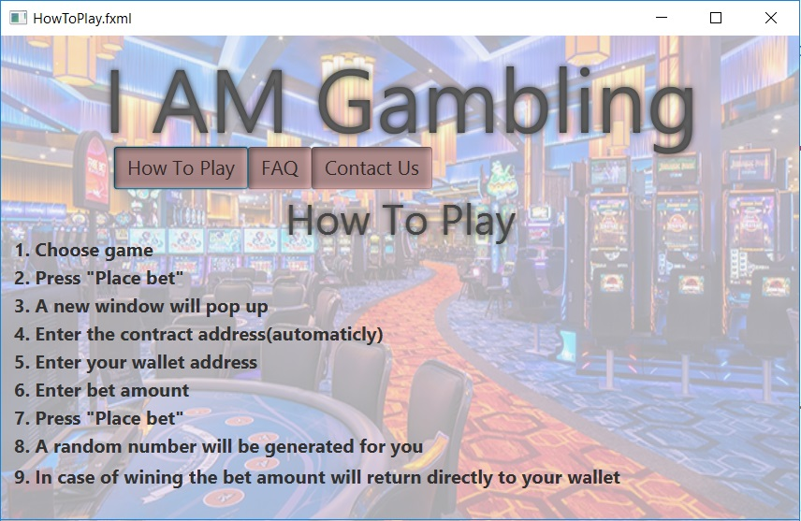
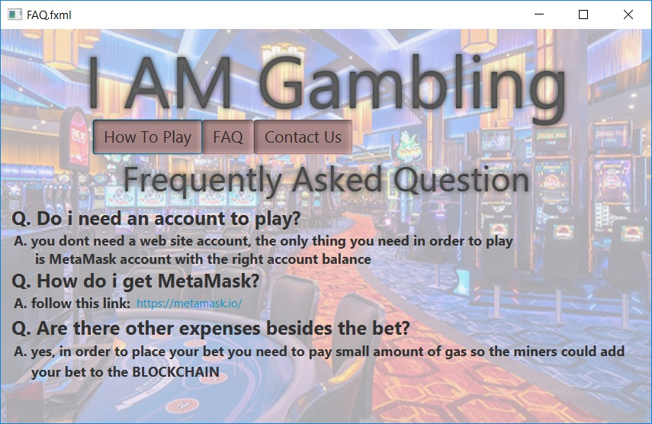


Slide 19
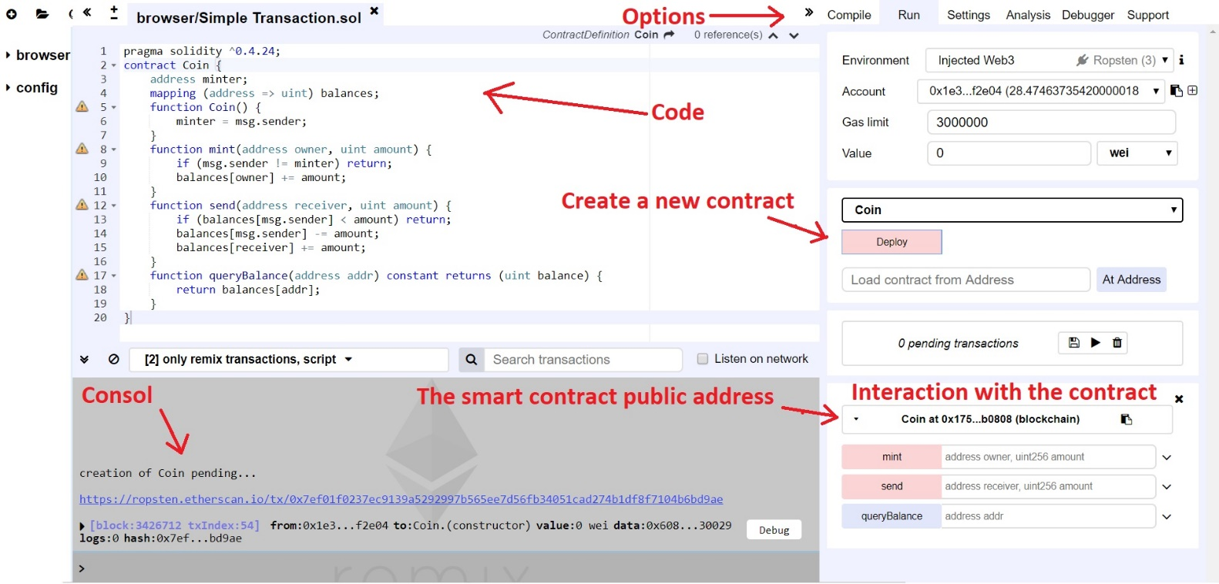
Smart contract environment
Notes:
This is related to our tests, we can actually test the functions that we wrote from this environment

Slide 20


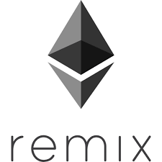
Testing
In our Project we have several layers to test:
The Network layer: Ropsten Test Network
The Transactions layer: Online Block Explorers -Etherscan
The Application layer: Table Testing, Remix-Solidity IDE
Notes:
Ropsten – is a test network, not the main network, so we wont spend real money.
Etherscan – is the website where we can see all the transactions in the network
Remix- is the environment to test our smart contract like I showed you before.

Slide 21
Testing - example
Expected result | Test | Test Number
Confirmation Massage “Processing your bet” | Successful Bet | 1
Error message “Please fill all the relevant information correctly". | Failure To Open New Game | 2
Confirmation massage “New game have been created, you can see it on the homepage". | Open Game Successfully | 3
Error Massage “There are no statistics to display". | Failed To Display Statistics | 4

Slide 22
